Slide 1
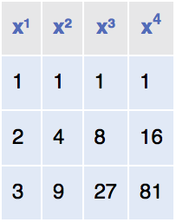

Nested Loops
One loop inside another loop.
Print a table of the powers of x, like this:
Pseudocode
Print table header.
For x from 1 to 4
Print table row.
Print new line.

Slide 2

Nested Loops
To print the values for each exponent requires a second loop
For n from 1 to 4
Print x^{n}.
The hour and minute displays in a digital clock are an example of nested loops.
The hours loop 12 times, and for each hour, the minutes loop 60 times.

Slide 3
section_8/PowerTable.java
1 /**
2 This program prints a table of powers of x.
3 */
4 public class PowerTable
5 {
6 public static void main(String[] args)
7 {
8 final int NMAX = 4;
9 final double XMAX = 10;
10
11 // Print table header
12
13 for (int n = 1; n <= NMAX; n++)
14 {
15 System.out.printf("%10d", n);
16 }
17 System.out.println();
18 for (int n = 1; n <= NMAX; n++)
19 {
20 System.out.printf("%10s", "x ");
21 }
22 System.out.println();
23
Continued

Slide 4
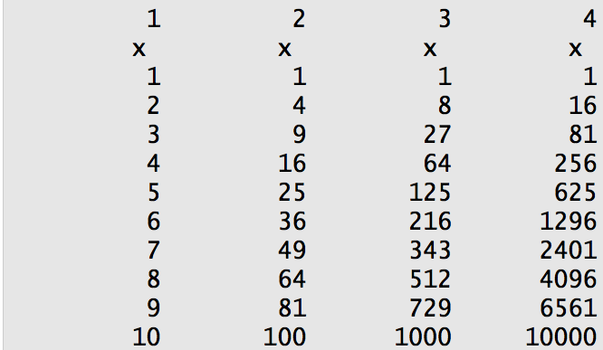
section_8/PowerTable.java
24 // Print table body
25
26 for (double x = 1; x <= XMAX; x++)
27 {
28 // Print table row
29
30 for (int n = 1; n <= NMAX; n++)
31 {
32 System.out.printf("%10.0f", Math.pow(x, n));
33 }
34 System.out.println();
35 }
36 }
37 }
Program Run

Slide 5
Self Check 6.37
Why is there a statement System.out.println(); in the outer loop but not in the inner loop?
Answer: All values in the inner loop should be displayed on the same line.

Slide 6
Self Check 6.40
What do the following nested loops display?
for (int i = 0; i < 3; i++)
{
for (int j = 0; j < 4; j++)
{
System.out.print(i + j);
}
System.out.println();
}
Answer: 0123 1234 2345

Slide 7
Self Check 6.41
Write nested loops that make the following pattern of brackets: [][][][] [][][][] [][][][]
Answer:
for (int i = 1; i <= 3; i++)
{
for (int j = 1; j <= 4; j++)
{
System.out.print("[]");
}
System.out.println();
}

Slide 8
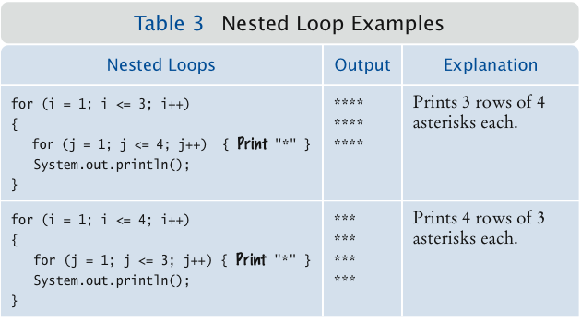
Nested Loop Examples

Slide 9
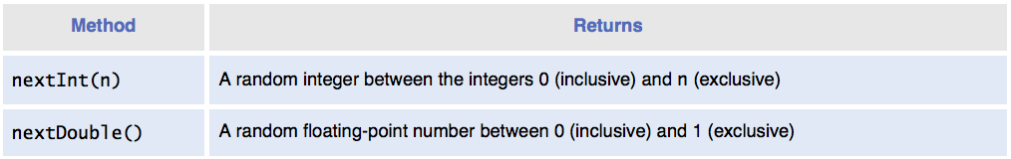
Application: Random Numbers and Simulations
In a simulation, you use the computer to simulate an activity.
You can introduce randomness by calling the random number generator.
To generate a random number
Create an object of the Random class
Call one of its methods

Slide 10
Application: Random Numbers and Simulations
To simulate the cast of a die:
Random generator = new Random()
int d = 1 + generator.nextInt(6);
The call generator.nextInt(6) gives you a random number between 0 and 5 (inclusive).
Add 1 to obtain a number between 1 and 6.

